Slide 1
Graph Database Neo4j
Zack Dai

Slide 2
Content
Part1 Graph Database Introduction
Graph Database
Comparison SQL with Neo4j
Use case of Neo4j
Part2 Practice with Neo4j
Neo4j playground online
Import data to Neo4j
Basic Queries
Advanced usage
Appendix: Learning Resources

Slide 3
Part 1
Graph Database Introduction

Slide 4
Graph Database
A graph is composed of two elements: a node and a relationship.
Each node represents an entity (a person, place, thing, category or other piece of data), and each relationship represents how two nodes are associated.

Slide 5
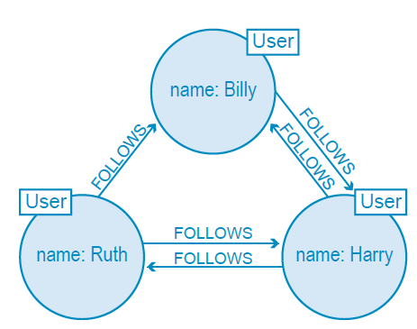
Graph Database
Twitter is a perfect example of a graph database connecting 313 million monthly active users. In the illustration to the right, we have a small slice of Twitter users represented in a graph data model.

Slide 6
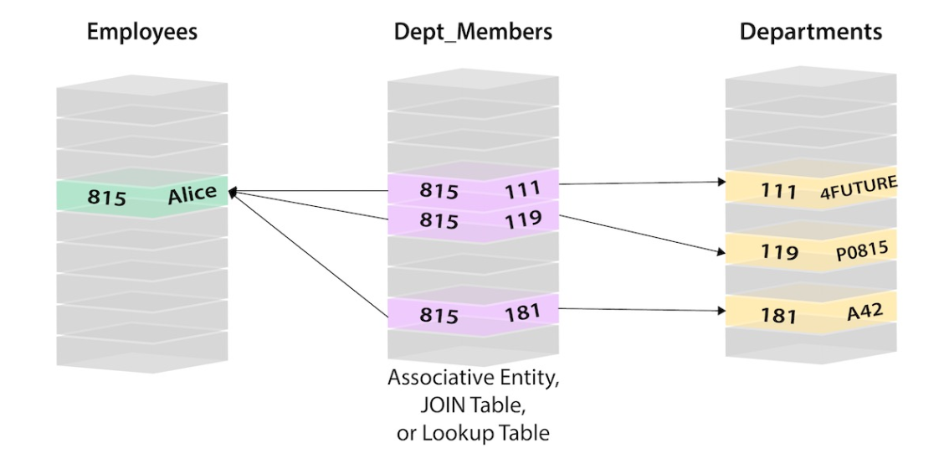
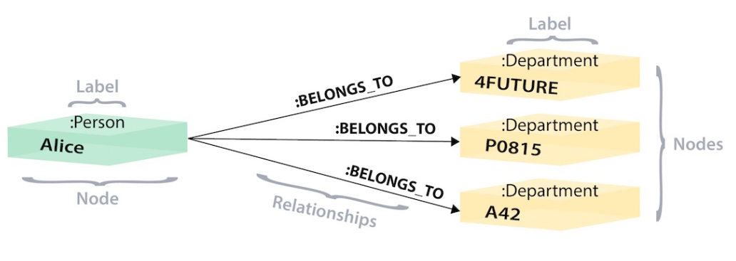
SQL vs NEO4j
SQL
NEO4j

Slide 7
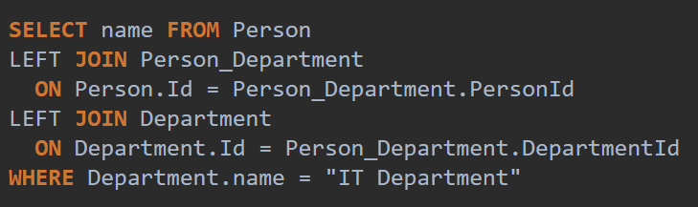
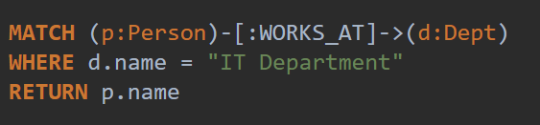
SQL vs NEO4j
SQL
NEO4j

Slide 8
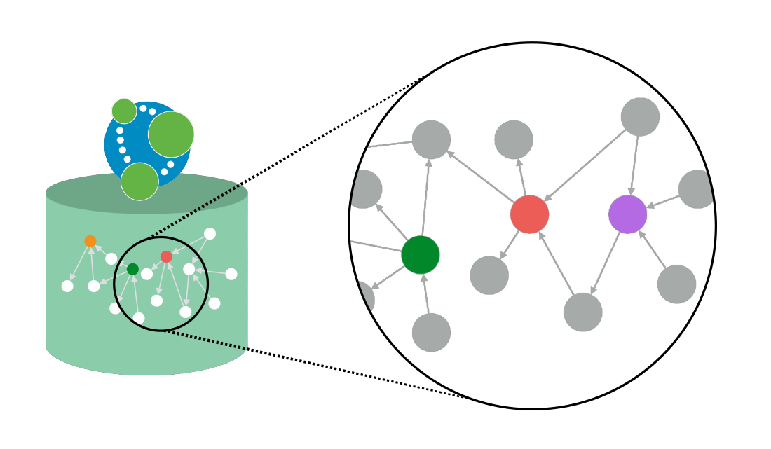
Advantages of NEO4j
Easy to Use
Visualization
Open Source
Fast
Support Network Algorism
Free Training and Certificate!

Slide 9
Neo4j Use Case
Fraud Detection
Knowledge Graph
Network and Infrastructure Monitoring
Recommendation System
Social Network Graph
AI and Analytics

Slide 10
Part 2
Practice with Neo4j

Slide 11
Neo4j playground online
https://neo4j.com/sandbox-v2/
Register an account.
Create a new sanbox (Spreadsheet Grapher)

Slide 12
Download The Dataset (Google Spread Sheet)
Social Nodes:
https://docs.google.com/spreadsheets/d/1CvEzIzAg--rMktjDcqCtrZ42TeYQQFueBZcQx0p8CQ4/edit?usp=sharing
Social Relation:
https://docs.google.com/spreadsheets/d/1hweXwMkSgfUNxVuflthbU8Gua1Yw328I8TEIgyUptAU/edit?usp=sharing
Load the file with your google spreadsheet

Slide 13
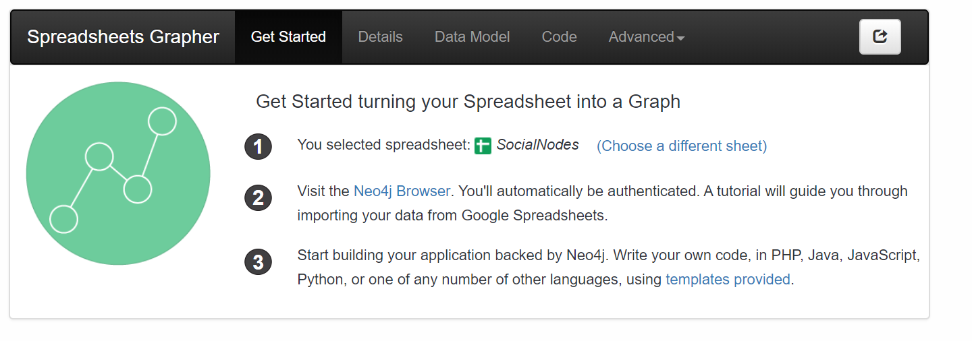
Link the data with sandbox
Select the data,
Click Neo4j Browser

Slide 14
Create Nodes
Use the “SocialNode.csv” as the file
Follow the instruction in the Neo Browser
When you get the query step
Change the last line of the query “Return row” to
“MERGE (u:User {id: row.id}) return u”

Slide 15
Create Relationships
Go back to the sanbox page, change the data source to “socialRelation.csv”
Restart the neo browser
Skip the introduction, run the default query (starts with “:play”),
Click the first “Loadcsv query”
In the query input box, change the last line (return row) into
MATCH (s:User {id: row.src})
MATCH (d:User {id: row.dst})
MERGE (s)-[:FOLLOWS]->(d)
return s,d

Slide 16
Basic Queries
Match (u:User) return count(u)
Match (u:User {id:"James"}) return u
Match (u:User) where u.id contains "a" return u
match (u:User)-[:FOLLOWS]->(u2:User) where u.id = "Mark" return u,u2
match (u:User)-[:FOLLOWS]->(u2:User) where u.id = "Mark" return u2.id
match (:User)-[r]->(:User) return count(r)

Slide 17
Advanced Neo4j
Follow the sanbox demo (Crime detection)

Slide 18
Appendix: Learning Resources
Download Neo4j https://neo4j.com/download/?ref=product
Use Neo4j on Cloud https://neo4j.com/sandbox-v2/
Free official ebooks https://neo4j.com/books/
Get Certificate https://neo4j.com/graphacademy/neo4j-certification/

Slide 19
Homework
Download the file:
Swnodes.csv
https://drive.google.com/file/d/1Z4E990JPxL0i7q2k79MxNgVdhFE7c2tT/view?usp=sharing
Swrelation.csv
https://drive.google.com/open?id=1koI6ipad-hEZM5RolMzFt0QituoN2ISu
Open them in your googlespread sheet

Slide 20
Homework
Create a NEO4j googlespreadsheet
(If you already have one goto the sandbox page, choose the sanbox -> advanced->shutdown sandbox
Refresh your page, create a new one)

Slide 21
Homework Question1
Load the two files into the database. Make a screenshot of the graph shows the relation and the nodes.
Note: for node use “MERGE (:Library {id: row.id})”
For relations use
MATCH (source:Library {id: row.src})
MATCH (destination:Library {id: row.dst})
MERGE (source)-[:DEPENDS_ON]->(destination)

Slide 22
Homework Question2
(Write the query and the answer)
How many nodes in the database?
How many nodes contains “p” in their id?
How many nodes contains “o” and also contains “a” in their id?What are they?
How many libraries depends_on “numpy”? what are they?

Slide 23
Homework Question3
Start a Trumpworld sandbox and answer:
a. What are the most connected organizations? List the top5 names.
b. What’s the connection between Donald Trump and Vladimir Putin? List all the names.

Slide 24
Homework Question4
From your experience, What are the reasons than you want or not want to use NEO4j/Graph database?

